Slide 1
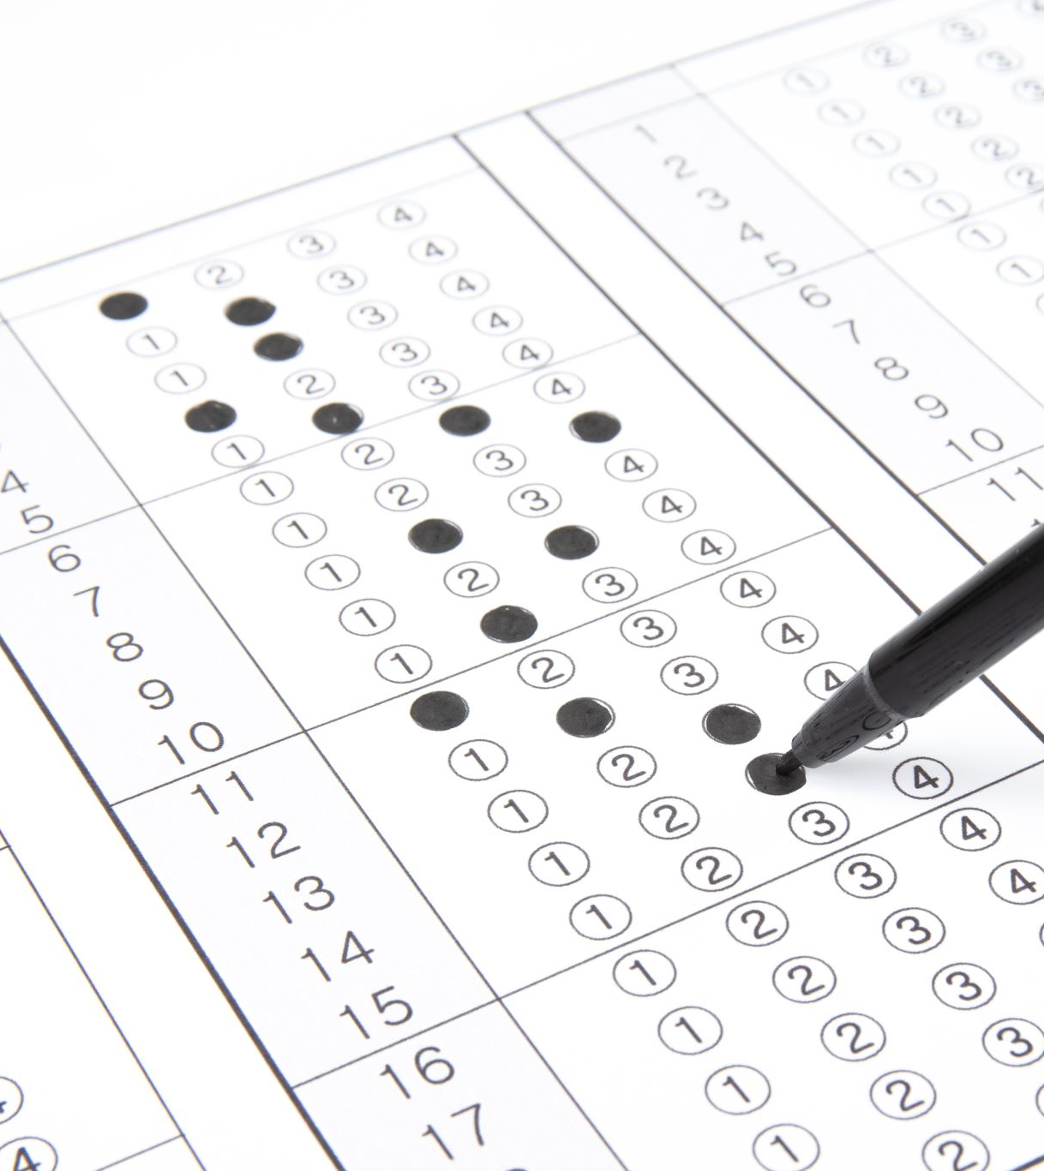
PLAGIARISM CHECKER
ARITIFICIAL INTELLIGENCE
CSE3013
REVIEW-01
Submitted to
-Dr. T Benil

Slide 2
TEAM MEMBERS
GANDLA PRAVALIKA-20BCE1277
01
KATASANI DURGA PRAVALIKA-20BCE1427
02
RAPARLA PUJASRI PAVANI-20BCE1587
03

Slide 3
LITERATURE SURVEY

Slide 4

ARTICLE-01
Advancements in Algorithmic Detection:
Recent studies have focused on enhancing the core algorithms used by plagiarism checkers. For example, Joshi, Shah, and Dave (2020) conducted a comprehensive survey on plagiarism detection methods, highlighting the utilization of natural language processing (NLP) techniques, machine learning, and artificial intelligence (AI) to improve detection accuracy. Such advancements have made it possible to identify various forms of plagiarism, including paraphrasing and mosaic plagiarism.

Slide 5

ARTICLE-02
Addressing Multilingual Plagiarism:
In our increasingly interconnected world, addressing plagiarism across multiple languages has become crucial. Hassan, Al-Zaidi, and Al-Zaidi (2019) conducted a comparative review of multilingual plagiarism detection systems. Their research delved into the development of tools capable of detecting plagiarism in various languages, taking into account language-specific nuances, thereby contributing to global academic integrity.

Slide 6

ARTICLE-03
Ethical Implications and False Positives:
While plagiarism checkers are essential for maintaining academic integrity, ethical concerns have arisen, and the issue of false positives remains significant. Zhang, Sun, and Liao (2017) conducted an investigation into plagiarism detection services, considering accuracy, similarity indexing, and the implications of false accusations. This research provides insights into the ethical dimensions of plagiarism detection.

Slide 7

ARTICLE-04
Integration into Educational Platforms:
Plagiarism checkers have become integrated into educational platforms and content management systems to facilitate real-time checks. Duan, Luo, and Zhou (2018) conducted an empirical study focusing on the user experience and effectiveness of such integrations. Their research contributes to improving the usability and impact of plagiarism detection tools in educational settings.

Slide 8

ARTICLE-05
Open Source vs. Commercial Solutions:
The debate over open-source versus commercial plagiarism checkers continues to be relevant. Kumar, Saini, and Bhaskar (2020) conducted a comparative analysis of these solutions, evaluating factors such as effectiveness, cost, and user satisfaction. Their research sheds light on the advantages and disadvantages of each type of plagiarism detection tool.

Slide 9
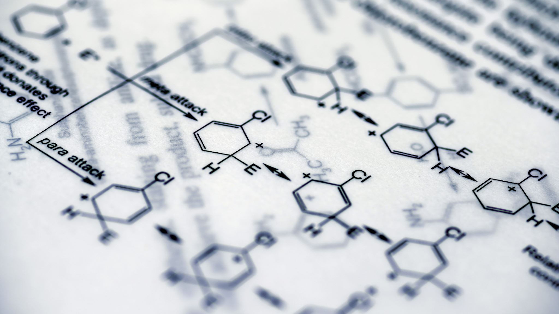
EXISTING SYSTEM
Several widely used plagiarism detection systems and tools were available to address the issue of plagiarism across different domains. Notably, Turnitin, a prominent system in academia, employed a vast database to identify potential plagiarism in academic papers. Grammarly offered a plagiarism checker as part of its suite, aiding writers in detecting and rectifying plagiarism by comparing content to web sources and academic papers. Copyscape was predominantly utilized for web content plagiarism checks, while Plagscan catered to educational institutions and publishers with detailed reports on plagiarized content. Other tools such as DupliChecker, Viper, and SafeAssign served students, educators, and institutions in identifying instances of plagiarism. Additionally, plagiarism detection tools designed for specific contexts, such as Moss for programming assignments and Citeulike for research papers, provided valuable assistance to users. It's important to note that the landscape of such tools may have evolved since 2021, with new offerings and updates potentially impacting their effectiveness and popularity.

Slide 10
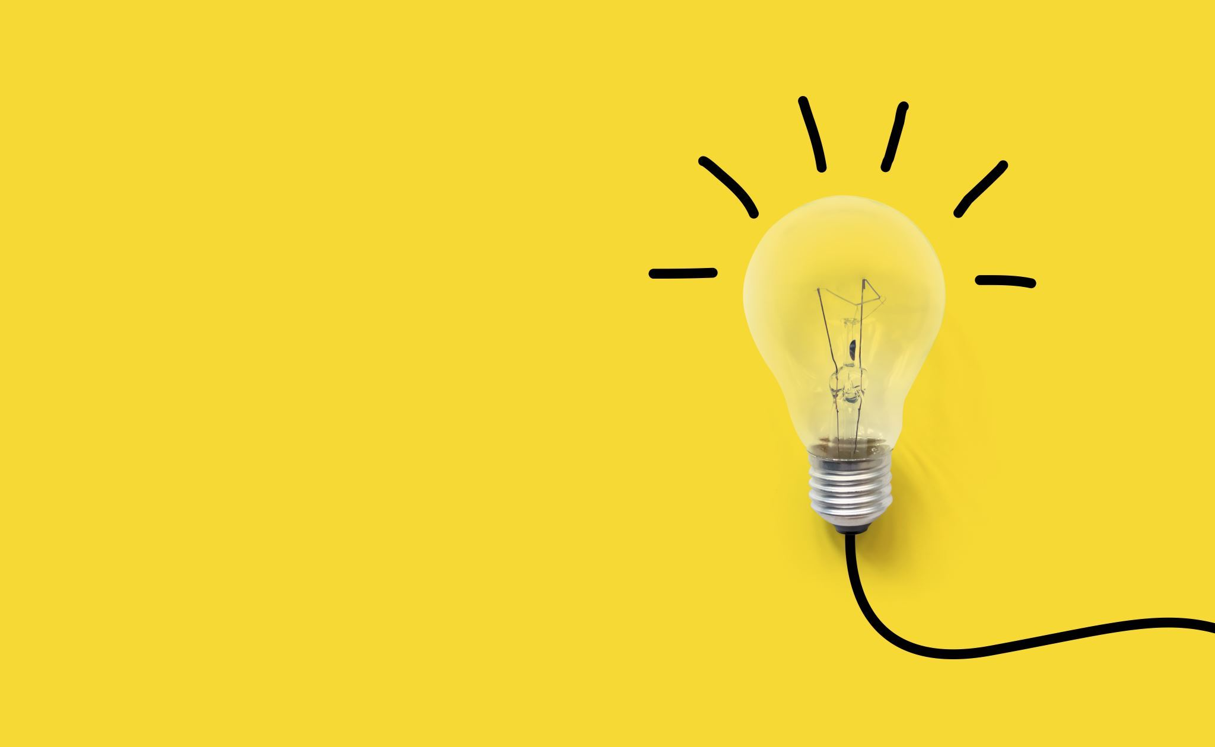
PROPOSED SYSTEM
The proposed Plagiarism Detection System represents a comprehensive solution designed to combat plagiarism effectively while accommodating the unique needs of various user groups. At its core, the system will utilize cutting-edge algorithms, including natural language processing and machine learning, to meticulously scan and identify instances of plagiarism, ranging from straightforward text copying to intricate paraphrasing and mosaic plagiarism. What sets this system apart is its commitment to supporting multiple languages, ensuring accurate checks in diverse linguistic contexts, thereby catering to a global user base.Moreover, customization and scalability are fundamental principles of this system's design. Users will have the flexibility to tailor plagiarism detection settings to their specific requirements, adapting the system to various academic disciplines, industry niches, or content types. Simultaneously, the system will be engineered to scale efficiently, accommodating a growing database of academic and web content for more accurate comparisons and broader coverage.

Slide 11
PROPOSED SYSTEM
Ethical considerations are paramount in the system's framework. In addition to identifying instances of plagiarism, it will incorporate educational features aimed at fostering an understanding of ethical writing practices, helping users avoid unintentional plagiarism and fostering a culture of responsible scholarship and content creation. Robust privacy measures will be in place to safeguard user data and content, ensuring confidentiality and data protection.
The system's reporting capabilities will be robust, generating comprehensive plagiarism reports that not only pinpoint plagiarized sections but also provide clear references to the original sources, facilitating a streamlined and informed process for addressing issues identified. By offering these features and benefits, the proposed Plagiarism Detection System aspires to become an indispensable tool for educators, students, journalists, writers, and content creators alike, championing integrity, originality, and ethical writing practices across domains and industries.

Slide 12

REQUIREMENTS
We are using python programming language to code the plagiarism checker.
We are using various python libraries in our program, some of them are os and sklearn.
Our group will perform the coding on google colab

Slide 13
REFERENCES
Joshi, M., Shah, M., & Dave, M. (2020). A Comprehensive Survey on Plagiarism Detection. International Journal of Computer Applications, 167(2), 25-32.
Hassan, S., Al-Zaidi, A., & Al-Zaidi, I. (2019). A Comparative Review of Multilingual Plagiarism Detection. International Journal of Advanced Computer Science and Applications, 10(7), 358-363.
Duan, R., Luo, Y., & Zhou, H. (2018). An Empirical Study of Plagiarism Detection across Programming Languages. Information and Software Technology, 101, 37-51.
Zhang, Z., Sun, Y., & Liao, Q. (2017). An Investigation into Plagiarism Detection Services: Accuracy, Similarity Indexing, and Implications. Journal of Information Science, 43(1), 54-65.
Kumar, S., Saini, A., & Bhaskar, P. (2020). Comparative Analysis of Open Source and Commercial Plagiarism Detection Tools. International Journal of Innovative Technology and Exploring Engineering, 9(4), 2382-2385.

Slide 14

THANK YOU

